Slide 1


Predicting Arrests in Chicago Crime Data
In Chicago, predicting arrests based on historical crime data is crucial for improving public safety and policing strategies. Leveraging advanced statistical and machine learning methods can uncover patterns and key factors influencing arrest likelihood in reported crime incidents.
The team of researchers includes
Ankita Tripathy
Fabrizio Petrozzi
Muhammad Hammaz,
Priyanka Jammu
Sai Praneetha Sigharam
Subham Mohanty

Slide 2

Importance of Public Safety
Predicting Arrest Likelihood
Using crime data to identify key factors that increase the chances of an arrest, such as crime type, location, and time.
Smarter Policing Strategies
Helps allocate resources effectively, focusing on high-risk locations and times for proactive intervention to reduce crime.
Enhanced Community Safety
Data-driven insights enable faster responses, improving arrest rates and ultimately leading to a safer community.

Slide 3

Key Questions Driving Our Analysis
1
What factors influence the likelihood of an arrest?
2
How can we create accurate arrest prediction models?
3
What is the business value of accurate arrest predictions?
Analyzing crime characteristics and contextual variables to identify the key predictors of arrests.
Evaluating different modeling approaches to find the most effective technique for forecasting arrests.
Examining how this analysis can support public safety initiatives and resource allocation decisions.

Slide 4
Data Characteristics
Data Sources
1
The dataset is sourced from the Chicago Data Portal, a comprehensive repository of public data related to the city of Chicago.
2
Dependent Variables
The main dependent variable in the dataset is Arrest, which indicates whether an arrest was made for a given incident.
Data Types
3
The dataset contains a mix of data types, including boolean, float, integer, and object.
4
Independent Variables
The key independent variables (DV's) include Primary Type, Domestic, Community Area, Year, and Location Description.
Data Size
5
The Chicago Crime dataset contains 221,635 rows and 24 columns, providing a substantial amount of information for analysis.

Slide 5
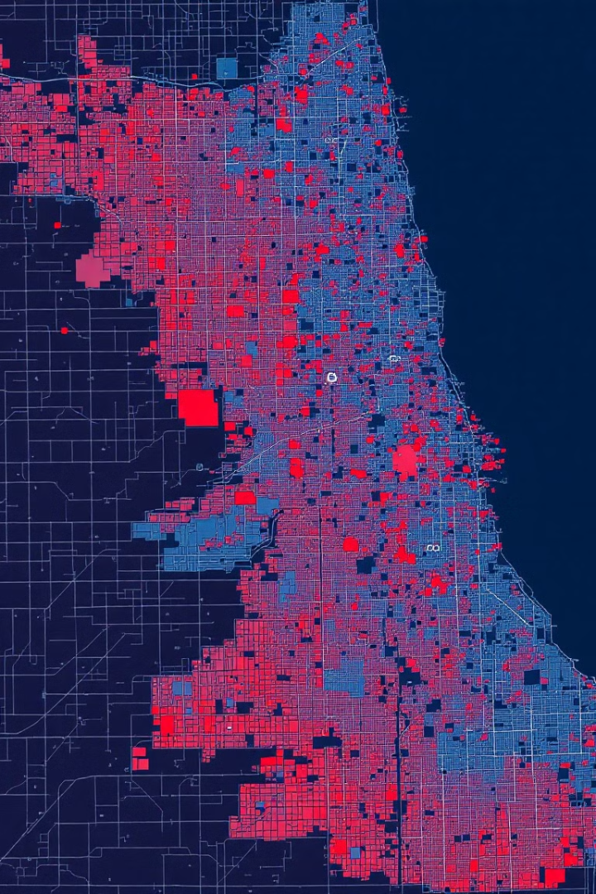
Data Preparation Process
1
Exploratory Data Analysis
Analyze the dataset to understand its characteristics, identify patterns, and uncover potential issues.
2
Class Imbalance Handling
Use oversampling techniques to balance the classes and improve the model's ability to predict the minority class outcomes..
3
One-Hot Encoding
Convert categorical features into a numerical format using one-hot encoding to prepare the data for modeling.
4
Standardization
Standardize the features to ensure they are on a similar scale, which can improve the model's performance.
5
Train-Test Split
Divide the dataset into training and testing sets to evaluate the model's performance on unseen data.

Slide 6
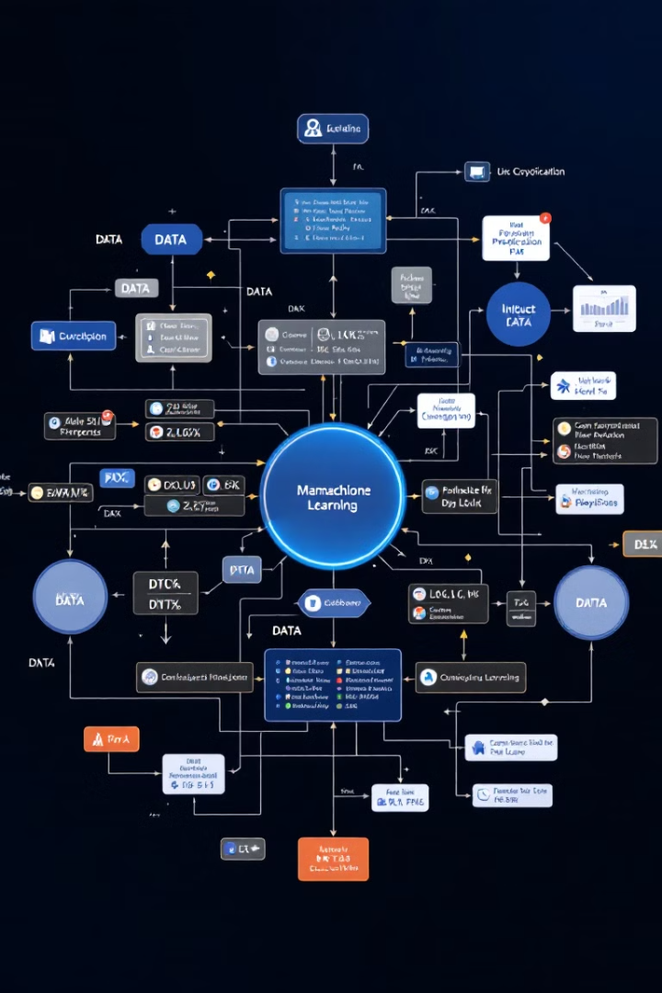
Modeling Approaches
Logistic Regression
Random Forest
Logistic Regression is a simple yet effective classification algorithm that is easy to interpret. It helps in understanding the significance of different predictors, such as "Primary Type" and "Domestic," and their impact on the likelihood of an arrest.
Random Forest is a robust ensemble model that effectively manages both numerical and categorical features. It is resistant to noise and overfitting due to its aggregation of multiple decision trees.
Neural Networks
Neural Networks are adept at modelling complex, non-linear relationships between features and the target variable, making them suitable for high-dimensional datasets.

Slide 7
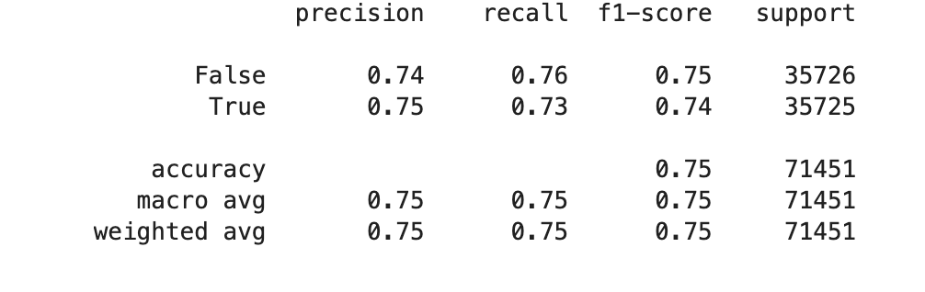
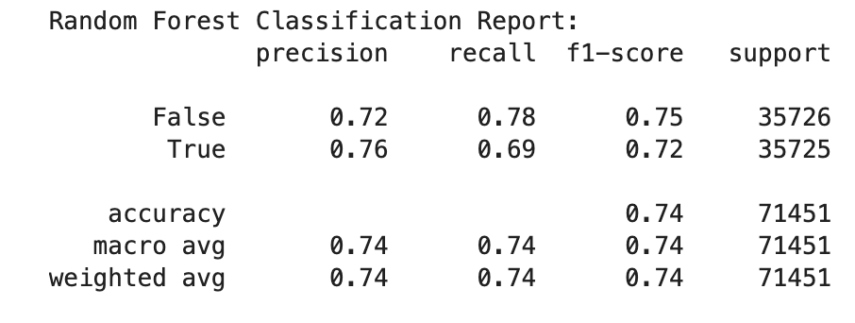
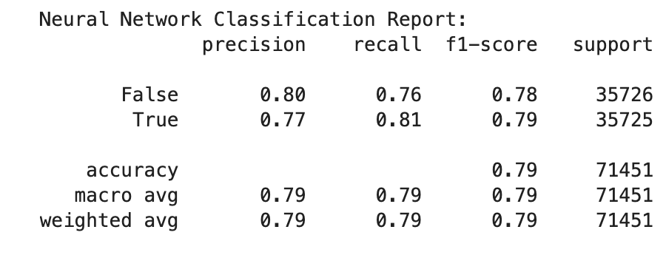
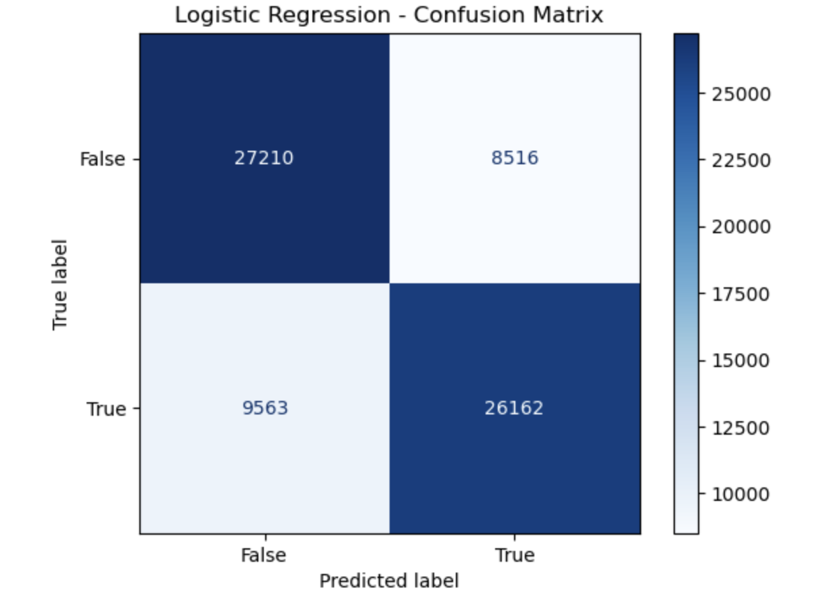
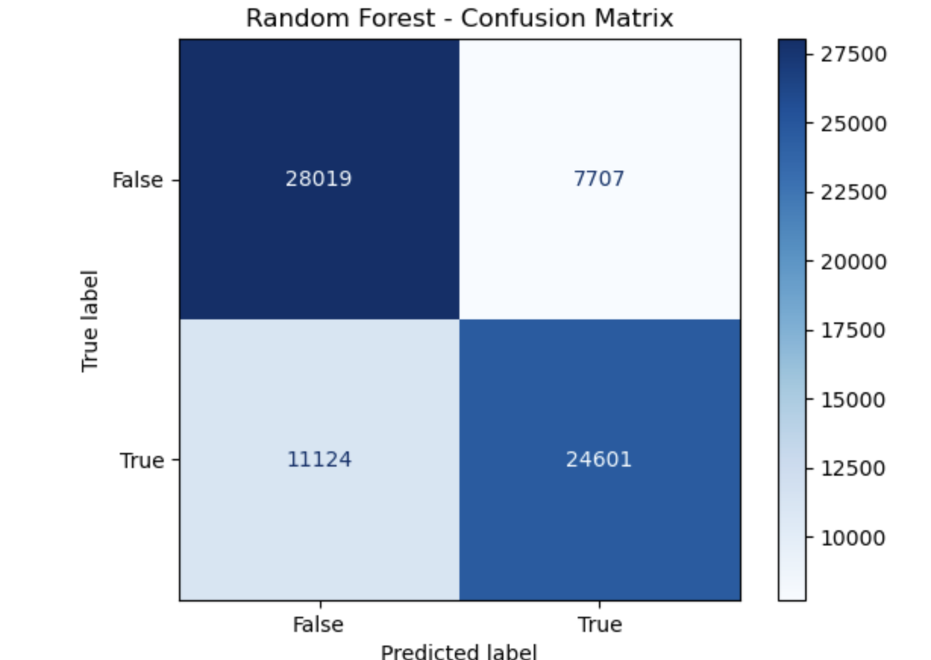
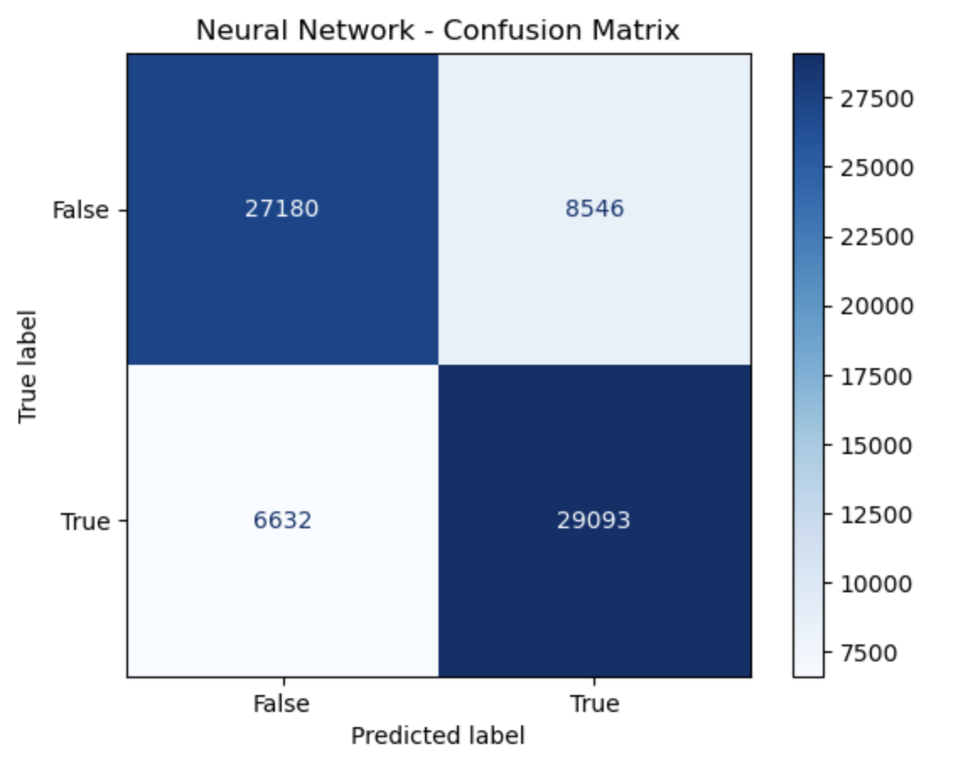
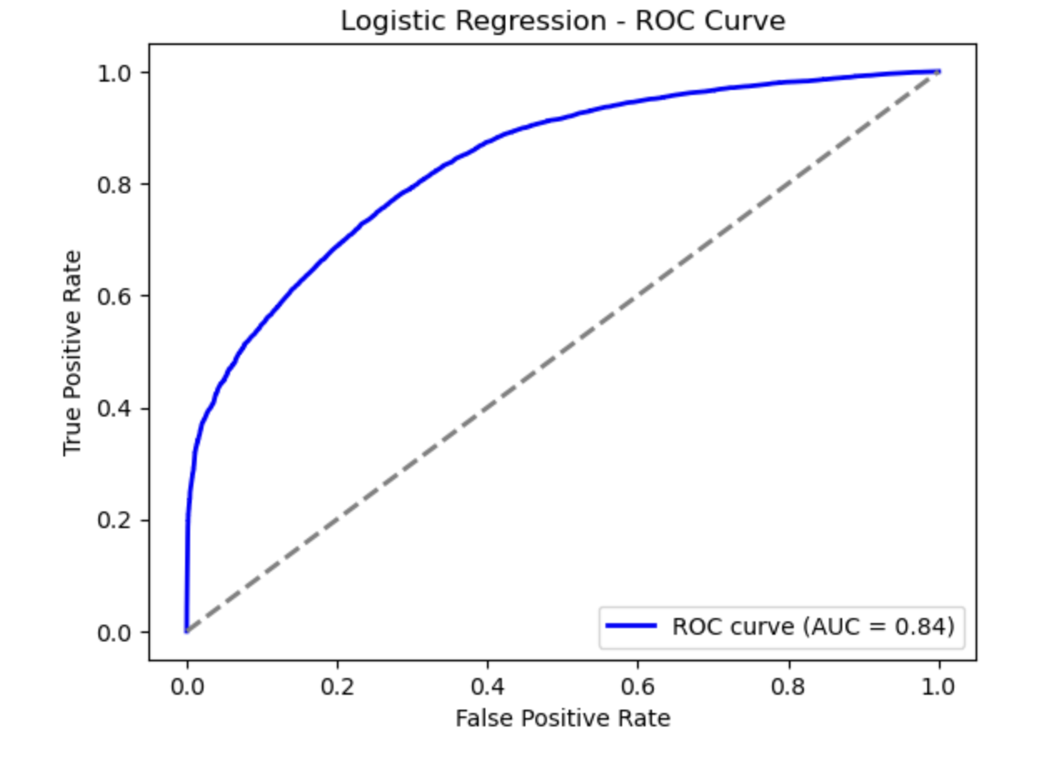
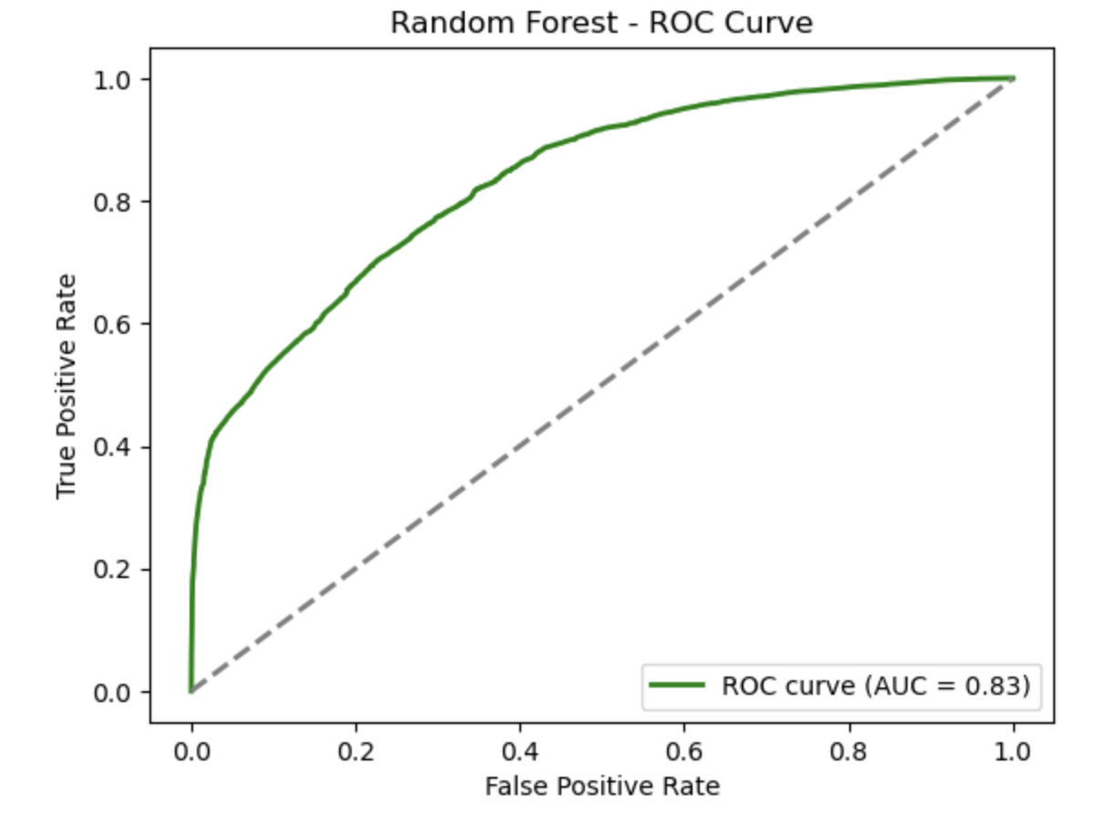
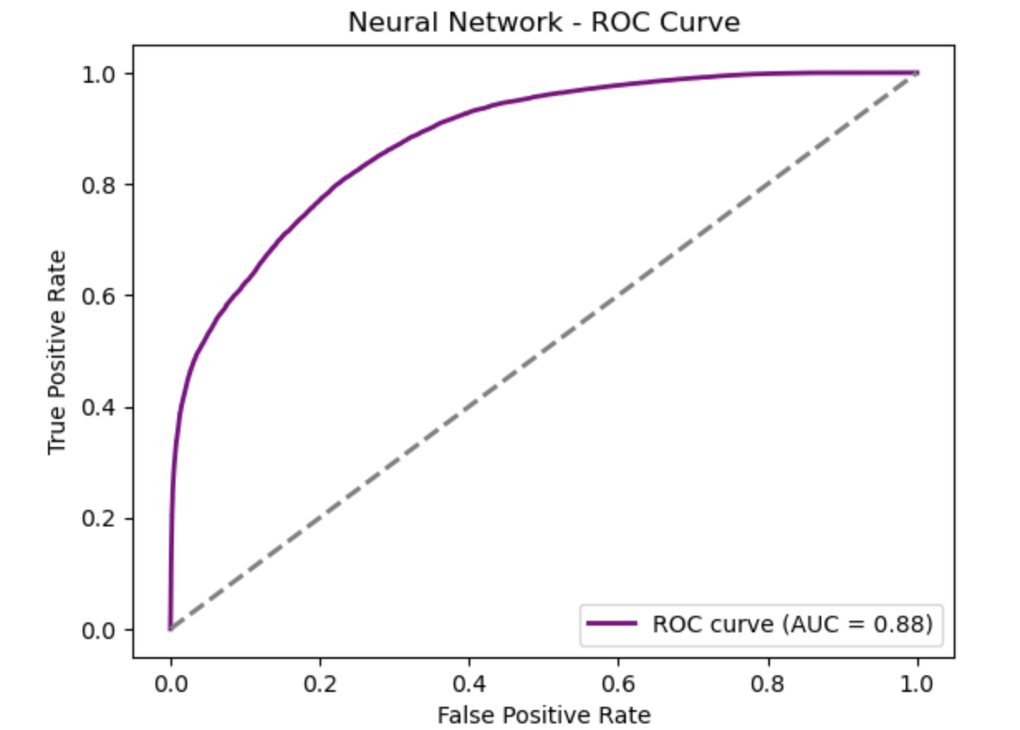

Evaluation of Modeling Approaches
Logistic Regression
Random Forest
Neural Network

Slide 8

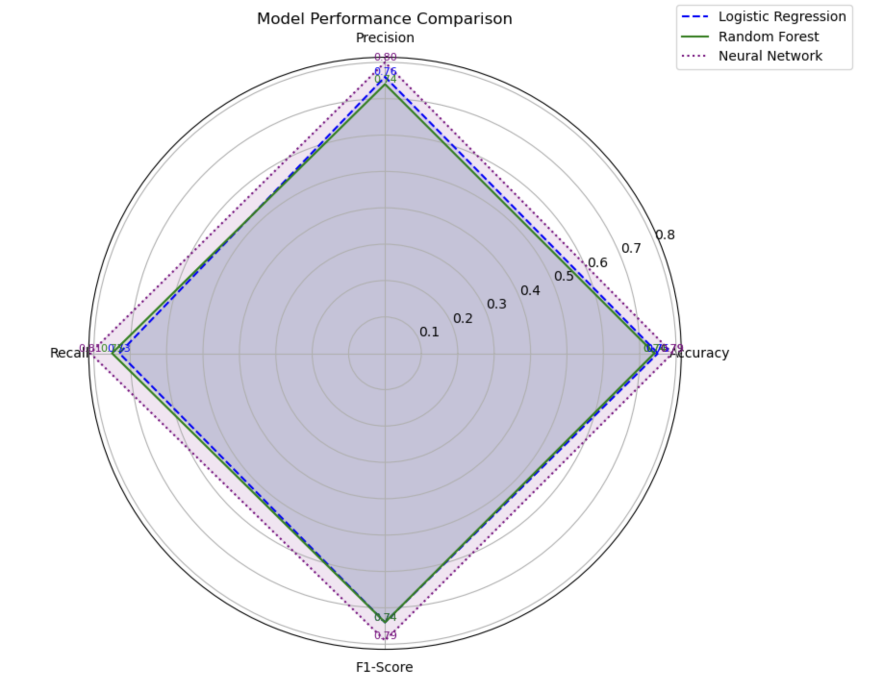
Best Performing Model
Neural Network Model
The Neural Network model emerges as the best-performing option, with the highest values across all the key metrics. Its balanced performance and ability to generalize well make it the optimal choice for this analysis.
Reasons for Selection
Superior Metrics: Highest Accuracy, Precision, Recall, and F1-Score
Balanced Performance: Minimizes false positives while capturing true positives
Generalized Performance: Demonstrates strong ability to generalize across the dataset

Slide 9






Business Value of Accurate Arrest Prediction
Resource Allocation
Targeted deployment of police officers and other public safety resources to high-risk areas.
Proactive Interventions
Identifying potential crime hotspots and implementing preventive measures.
Improved Outcomes
Reducing crime rates, increasing arrest rates, and enhancing overall public safety.
Operational Efficiency
Automate analysis to save time and costs
Policy and Planning Support
Inform long-term decisions on resource distribution

Slide 10

Conclusion and Next Steps
1
Continuous Model Refinement
2
Expanded Analysis
Exploring the drivers of different crime types and developing specialized models for each.
Incorporating new data and feedback to iteratively improve the arrest prediction models.
3
Collaborative Partnerships
Engaging with law enforcement agencies to integrate the models into their decision-making processes.

Slide 11
References
https://medium.com/analytics-vidhya/predicting-arrests-looking-into-chicagos-crime-through-machine-learning-78697cc930b9
https://www.kaggle.com/datasets/chicago/chicago-crime
https://data.cityofchicago.org/Public-Safety/Crimes-2001-to-Present/ijzp-q8t2/about_data
https://www.kdnuggets.com/2017/06/7-techniques-handle-imbalanced-data.html
https://github.com/Mayank-004/Boston-Crime
https://github.com/rahulbordoloi/Predict-Crime-Rate-in-Chicago/blob/master/Predict_Crime_Rate_in_Chicago.
https://www.kaggle.com/code/datajack1234/predicting-crime-rate-in-chicago-using-prophet
https://www.kaggle.com/code/threadid/chicago-crimes-regression-neural-network

Slide 12

¸z

